Slide 1



Slide 2


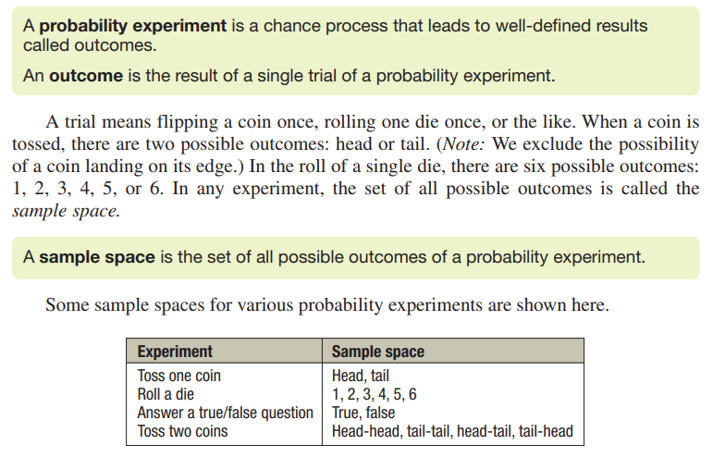

Slide 3
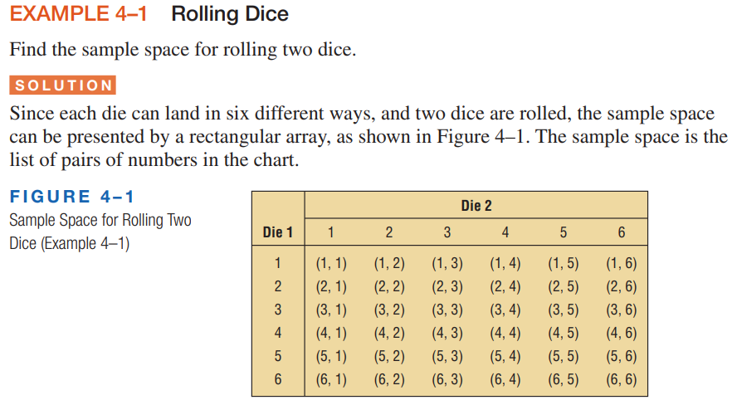

Slide 4



Slide 5

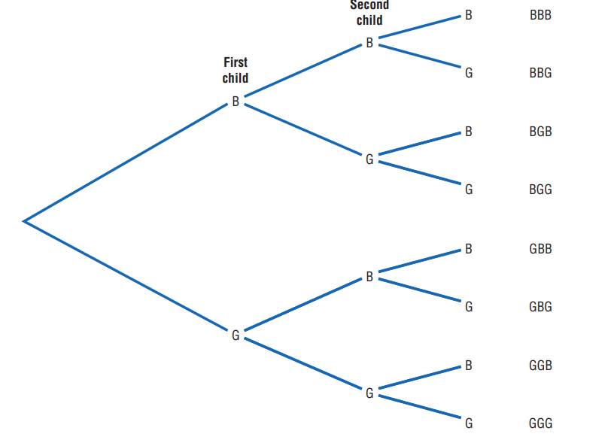


Slide 6

Event:
In probability theory, an event is any specific outcome or combination of outcomes from a random experiment. An event can be simple (involving a single outcome) or complex (involving multiple outcomes).

Slide 7

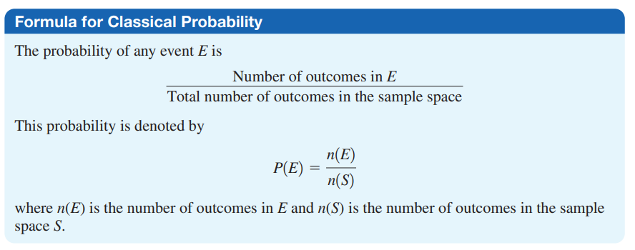
Classical probability refers to a type of probability that is based on equally likely outcomes.

Slide 8
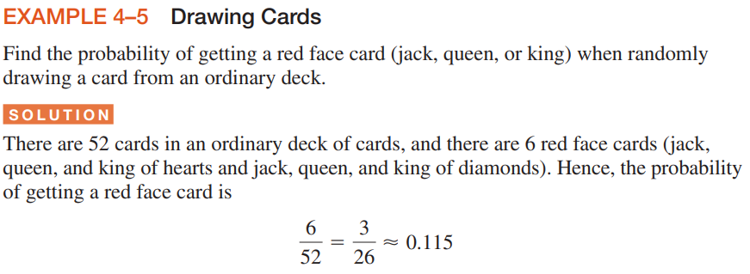


Slide 9

Solution: Page: 190- ref. book

Slide 10



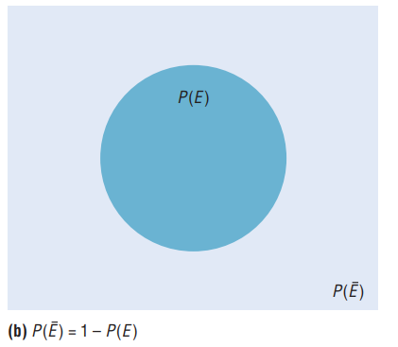

Slide 11




Slide 12
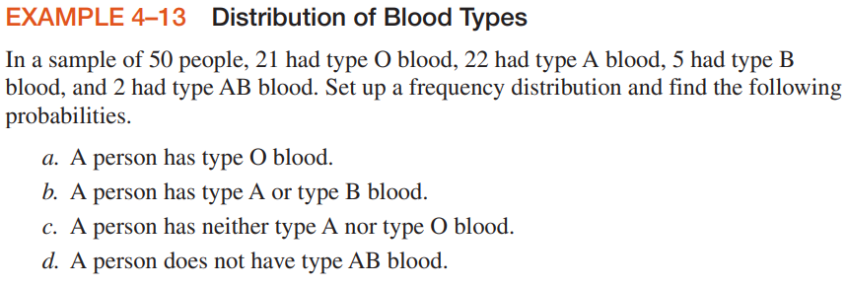
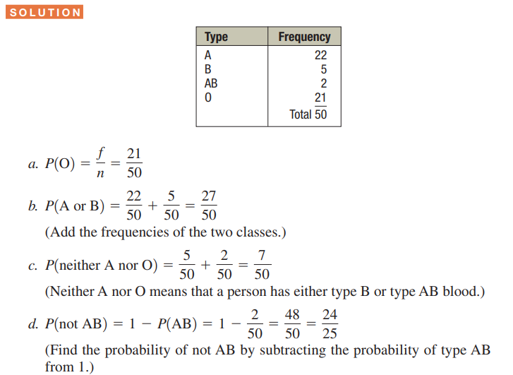

Slide 13
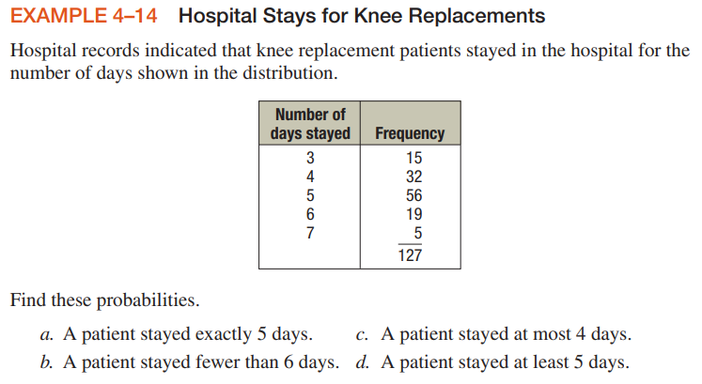
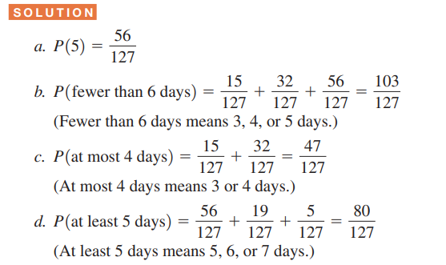

Slide 14
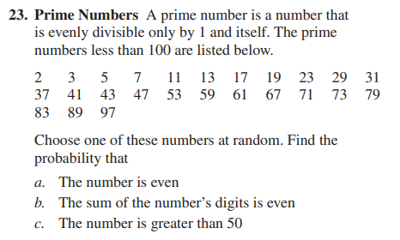
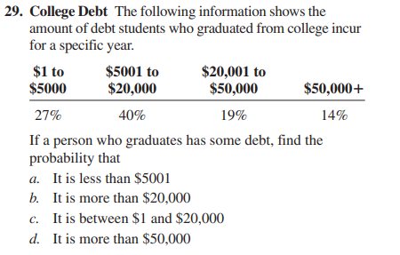

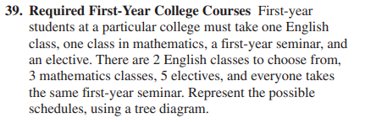
H.W:

